Slide 1
School of Instruction
Community Service
Loyalty Day
Safety
Department of Kansas

Slide 2
Community Service Reporting

Slide 3
Reporting
For the purposes of volunteer recognition, VFW community service hours must be performed by and as a representative of the Veterans of Foreign Wars. As it is the intent of VFW community service to impact a broad spectrum of the local community, the work must also be performed for an organization outside of the VFW and its Auxiliary, and must be verified by an authorized representative of that organization.
In addition, efforts performed for the benefit of the Post or Auxiliary should not be considered as community service

Slide 4
Examples of Good Reporting:
• Assisting of veterans within the community
• Scholarships to youth
• Sponsoring of youth teams
• VA hospital work on behalf of the VFW
• Blood drives
• Legislative town halls
• Care packages for troops, homeless etc.
• Register to Vote campaigns
• Food Bank support
• Building of ramps for disabled veterans
• Hosting job fairs
• Visiting VA Homes & nursing facilities
• Community Clean Up activities
• Natural Disaster Relief support
• Clothing Drives
• Donations to civic organizations within the community that align with our
values

Slide 5
Examples of Non-Qualified Community Service Events
• Flying the U.S. Flag
• Flying the POW Flag
• Post dinners
• Bingo
• Paid VFW Service Officer work
• Personal efforts of a member volunteering at a church or other nonprofit
organizations
• Buddy Poppy Drives
• Membership Drives
• Anything that directly benefits the Post
• Reciting the pledge of allegiance at a Post meeting
• Charging, renting or loaning the Post hall to their Auxiliary or Cootie Pup-Tent
Please note: These lists are not all inclusive but rather a frame of reference of
what is good to host and report versus what events should not be reported.

Slide 6
Value of a Volunteer Hour
Volunteers in the United States hold up the foundation of civil society. They help their neighbors, serve their communities and provide theirexpertise. No matter what kind of volunteer work they do, they contribute in invaluableways. According to its Value of Volunteer Time report, Independent Sector, together with the Do-Good Institute, announced in April 2023, that the latest value of a volunteer hour is $31.80
Value of a Mile
The rate for mileage in service or charitable organizations is currently at $0.14 per mile.

Slide 7
Total Impact
When figuring the total impact of your community service event, you must calculate the money spent on hosting and organizing the event,
Plus total hours all participating volunteers spent executing the event
Plus the mileage for all volunteers who participated.
This equals the total impact for the event, and when added up throughout the year can provide the Post’s annual community service total impact.
$ + Hours + Mileage = Total Impact

Slide 8
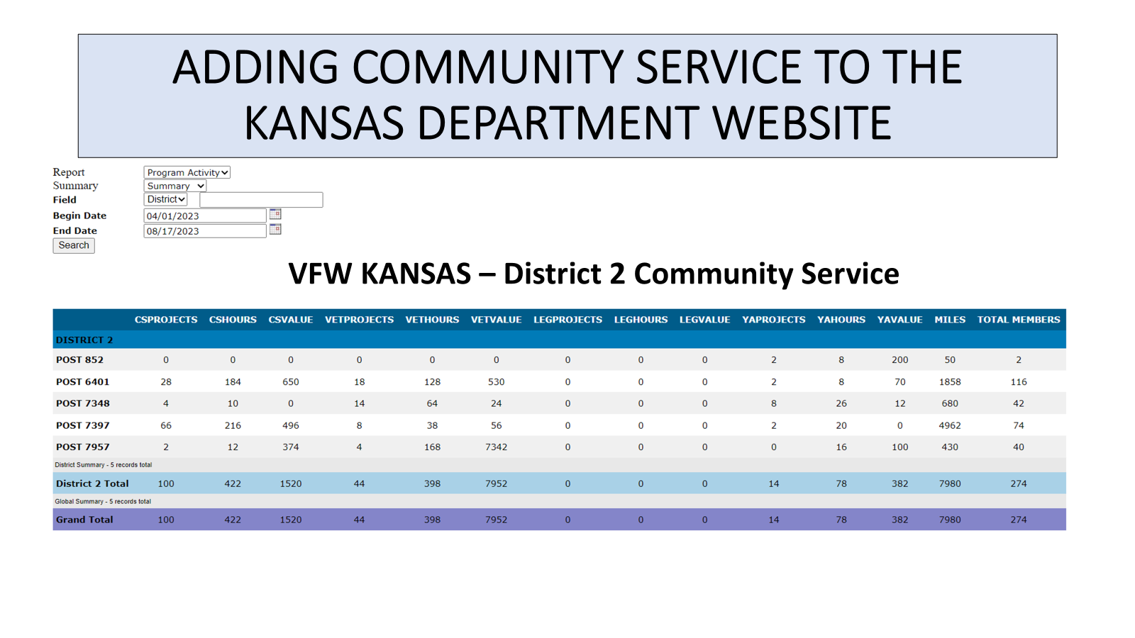

Slide 9
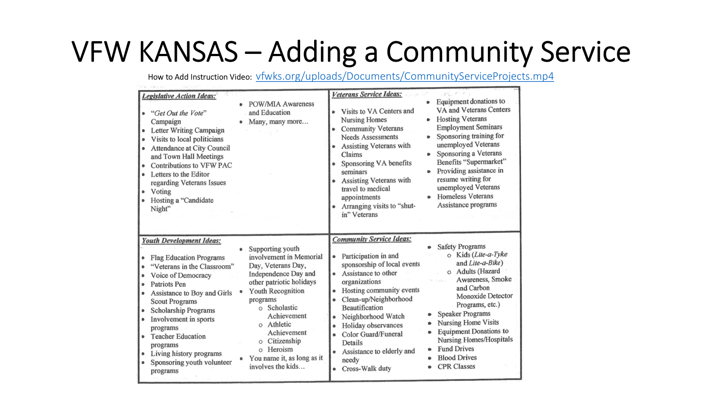

Slide 10
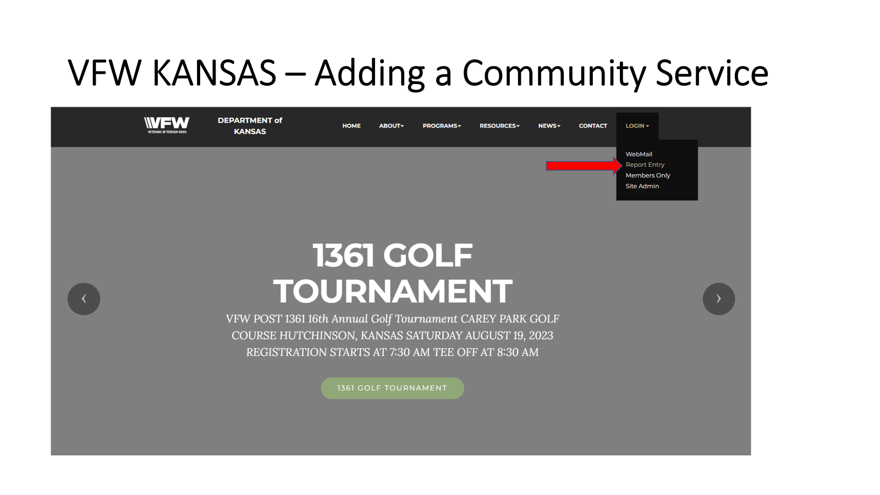

Slide 11
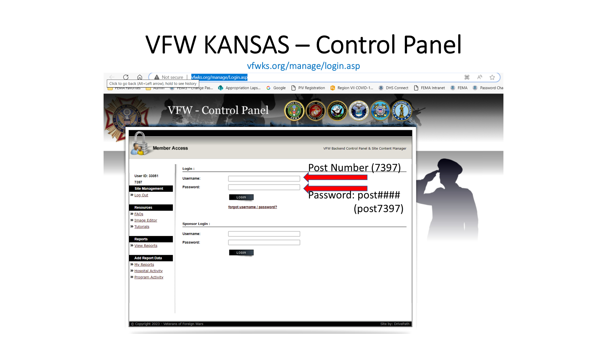

Slide 12
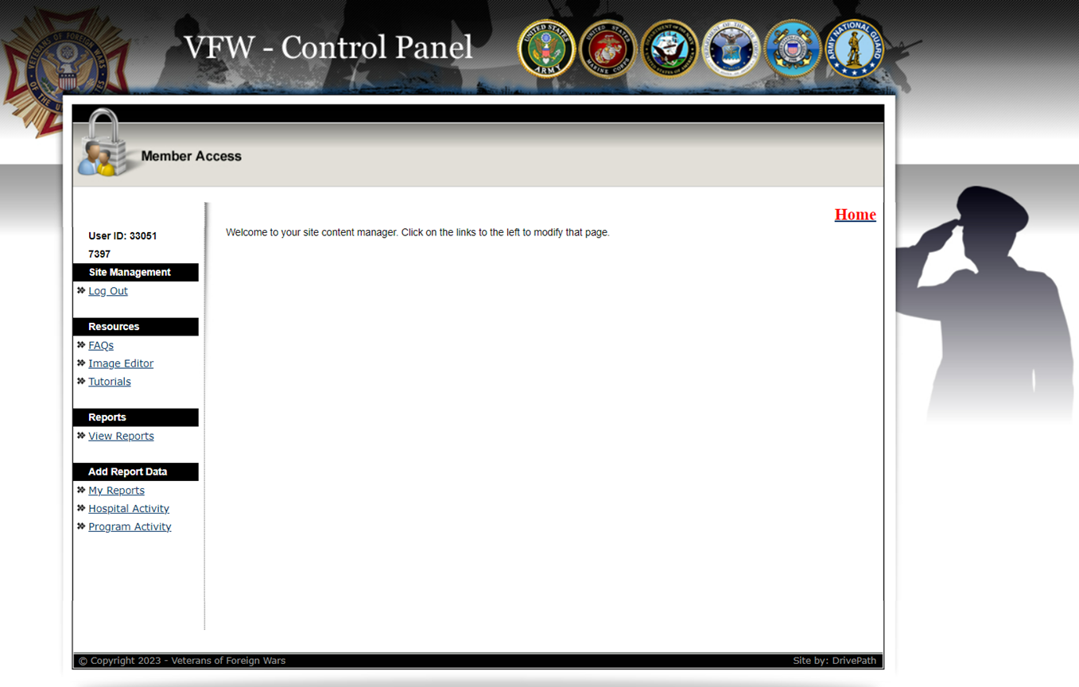

Slide 13
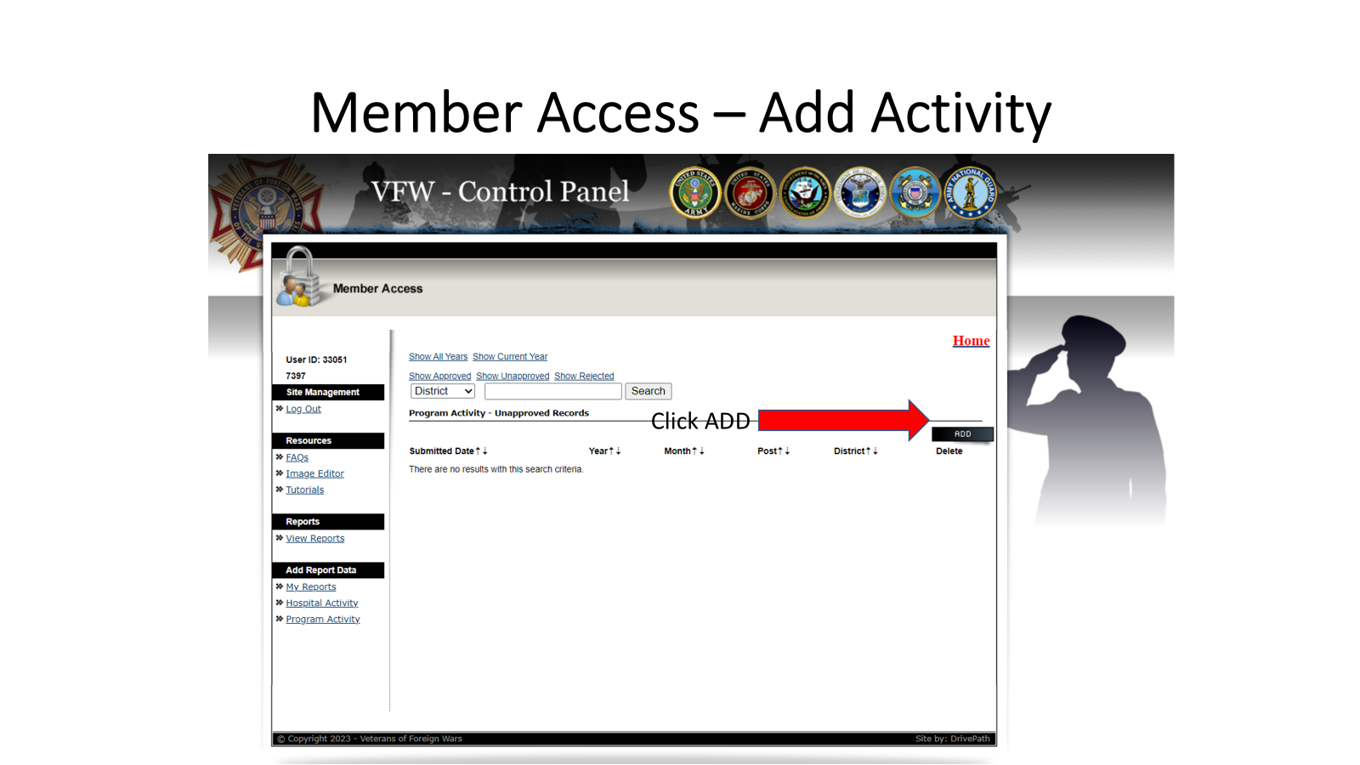

Slide 14
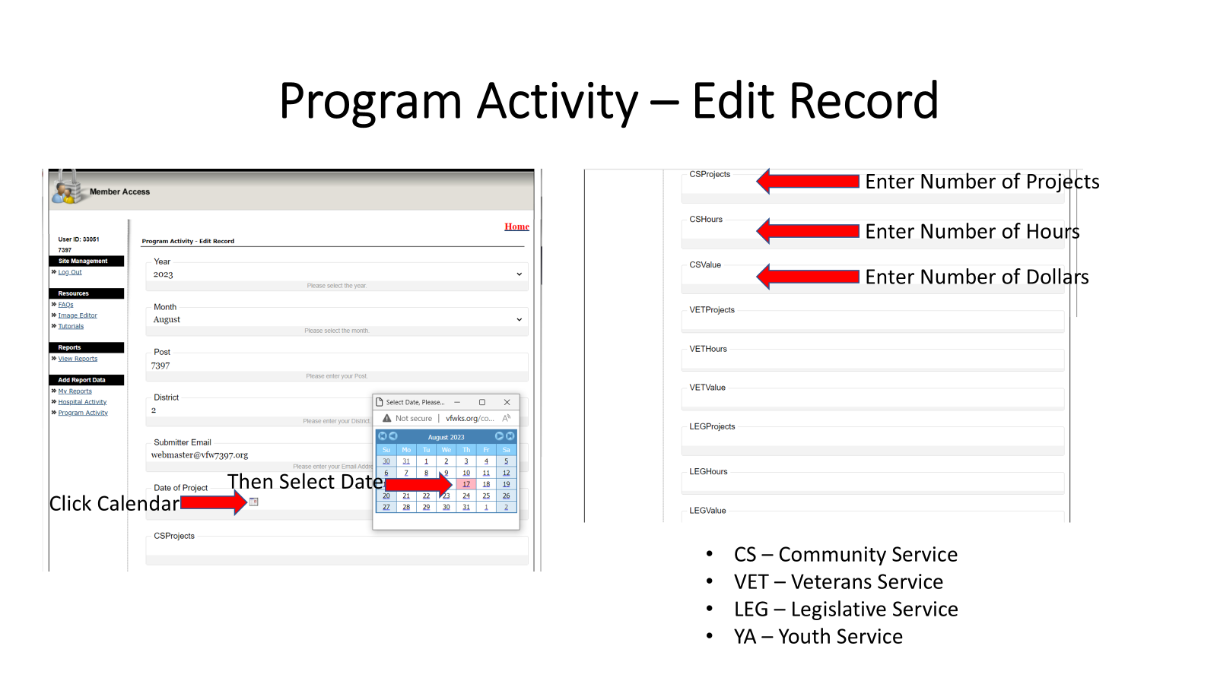

Slide 15
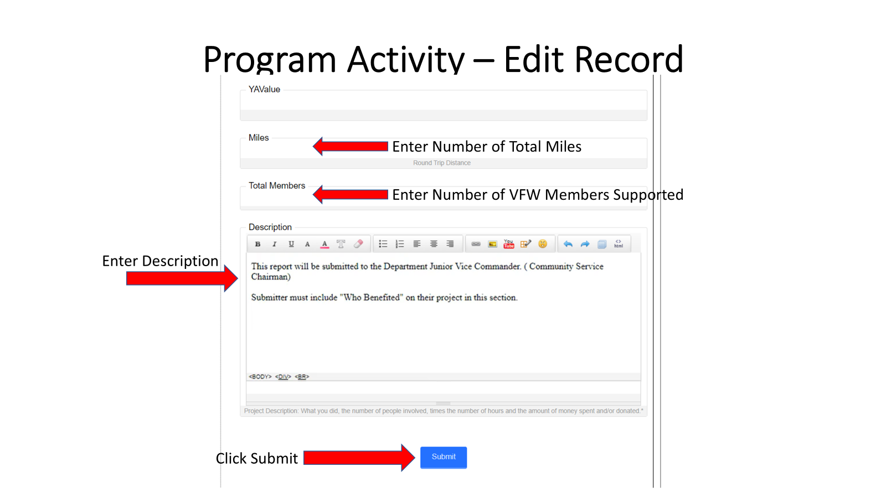

Slide 16
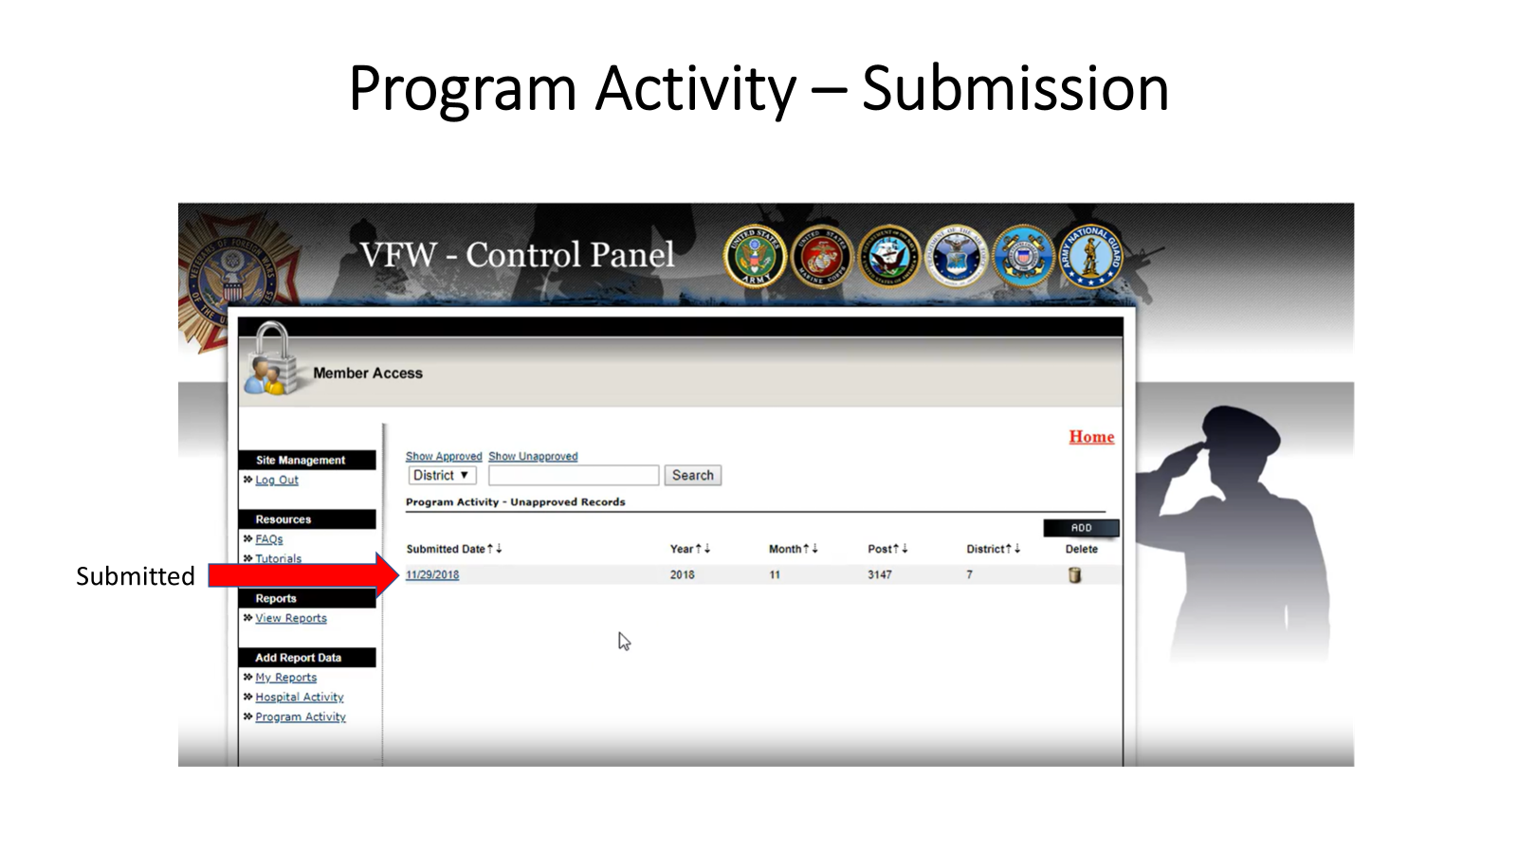

Slide 17
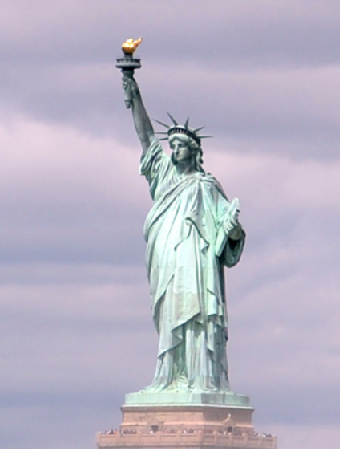
Loyalty Day
Loyalty Day originally began as "Americanization Day" in 1921 as a counter to the Communists' May 1 celebration of the Russian Revolution. On May 1, 1930, 10,000 VFW members staged a rally at New York's Union Square to promote patriotism. Through a resolution adopted in 1949, May 1 evolved into Loyalty Day. Observances began in 1950 on April 28 and climaxed May 1 when more than five million people across the nation held rallies. In New York City, more than 100,000 people rallied for America. In 1958 Congress enacted Public Law 529 proclaiming Loyalty Day a permanent fixture on the nation's calendar.

Slide 18
Questions
Rick McKenna
Junior Vice Commander
Department of Kansas
jvc@vfwks.org
913.481.2973

