Slide 1
School of Instruction
Community Service
Department of Kansas

Slide 2
Community Service Reporting

Slide 3
Reporting
For the purposes of volunteer recognition, VFW community service hours must be performed by and as a representative of the Veterans of Foreign Wars. As it is the intent of VFW community service to impact a broad spectrum of the local community, the work must also be performed for an organization outside of the VFW and its Auxiliary, and must be verified by an authorized representative of that organization.
In addition, efforts performed for the benefit of the Post or Auxiliary should not be considered as community service

Slide 4
Examples of Good Reporting:
• Assisting of veterans within the community
• Scholarships to youth
• Sponsoring of youth teams
• VA hospital work on behalf of the VFW
• Blood drives
• Legislative town halls
• Care packages for troops, homeless etc.
• Register to Vote campaigns
• Food Bank support
• Building of ramps for disabled veterans
• Hosting job fairs
• Visiting VA Homes & nursing facilities
• Community Clean Up activities
• Natural Disaster Relief support
• Clothing Drives
• Donations to civic organizations within the community that align with our
values

Slide 5
Examples of Non-Qualified Community Service Events
• Flying the U.S. Flag
• Flying the POW Flag
• Post dinners
• Bingo
• Paid VFW Service Officer work
• Personal efforts of a member volunteering at a church or other nonprofit
organizations
• Buddy Poppy Drives
• Membership Drives
• Anything that directly benefits the Post
• Reciting the pledge of allegiance at a Post meeting
• Charging, renting or loaning the Post hall to their Auxiliary or Cootie Pup-Tent
Please note: These lists are not all inclusive but rather a frame of reference of
what is good to host and report versus what events should not be reported.

Slide 6
Examples (yes or no)
• Post members provided Funeral & Visitation support and presented certificates for an Air Force Veteran to **** National Cemetery. Actions benefited the deceased and their family.
7.5 Hours $0.00 90 miles 5 members
• Post hosted the bi-weekly karaoke night Post and AUX members volunteered in Post Kitchen by cooking and serving food. Actions benefited the community and their families.
31.5 Hours $0.00 14 miles 7 members
• Post hosted the community’s weekly Bingo night. Members and AUX volunteered with Bingo organization and coordination along with 3 members and 2 AUX members volunteered in Post Kitchen by cooking and serving food. Actions benefited the community and their families.
49.5 Hours $0.00 22 miles 11 members
• Post members provided support for the community’s monthly Breakfast. Actions benefited the soldiers and their families.
32 Hours $300.00 6 miles 8 members
• MEMBERS REQUESTED CONGRESS TO REMOVE SEC. 108 FROM THE TAKE CARE OF AMERICAN VETERANS BILL. BENEFITED VETERANS
• Post Aux members supported a deceased Veteran and his family with the clean up of the property to include yard and house. Actions benefited the deceased his family the community and their families.

Slide 7
Examples (yes or no)
• 3 VFW POST MEMBERS SERVE ON THE LOCAL HOUSING BOARD
• Skippy and three other Clowns made balloon animals and entertained children at the Easter Egg Hunt in Any City.
Approximately $30 spent on Balloons.
• Legislative - Members of Post participated in the primary elections on 4 August 2026

Slide 8
Value of a Volunteer Hour
Volunteers in the United States hold up the foundation of civil society. They help their neighbors, serve their communities and provide their expertise. No matter what kind of volunteer work they do, they contribute in invaluable ways. According to its Value of Volunteer Time report, Independent Sector, together with the Do-Good Institute, announced in April 2023, that the latest value of a volunteer hour is $34.79
Value of a Mile
The rate for mileage in service or charitable organizations is currently at $0.14 per mile.

Slide 9
Total Impact
When figuring the total impact of your community service event, you must calculate the money spent on hosting and organizing the event,
Plus total hours all participating volunteers spent executing the event
Plus the mileage for all volunteers who participated.
This equals the total impact for the event, and when added up throughout the year can provide the Post’s annual community service total impact.
$ + Hours + Mileage = Total Impact

Slide 10
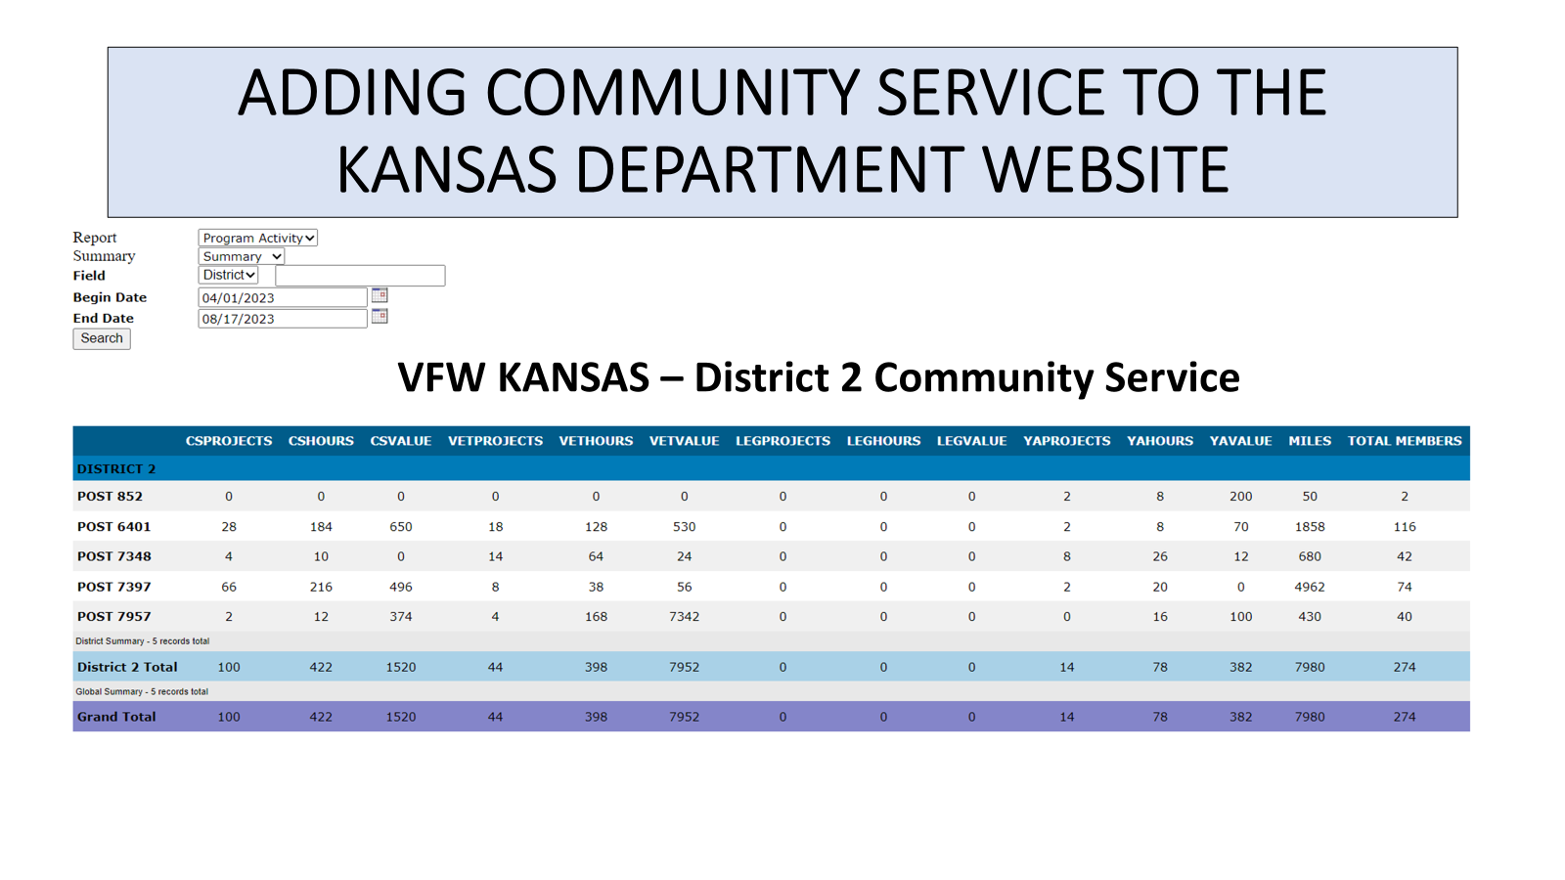

Slide 11
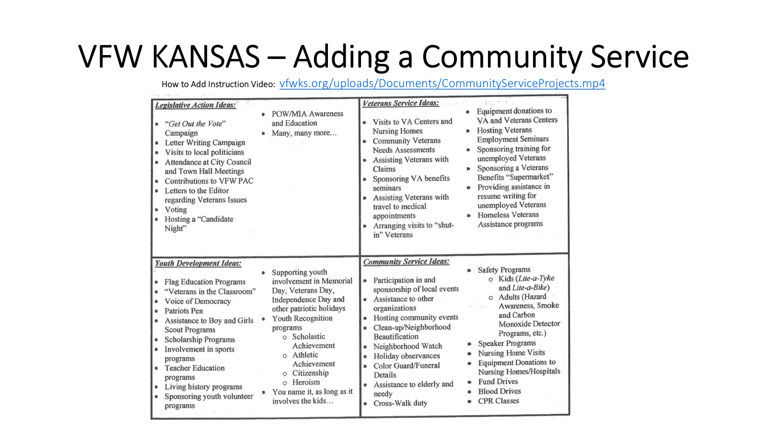

Slide 12
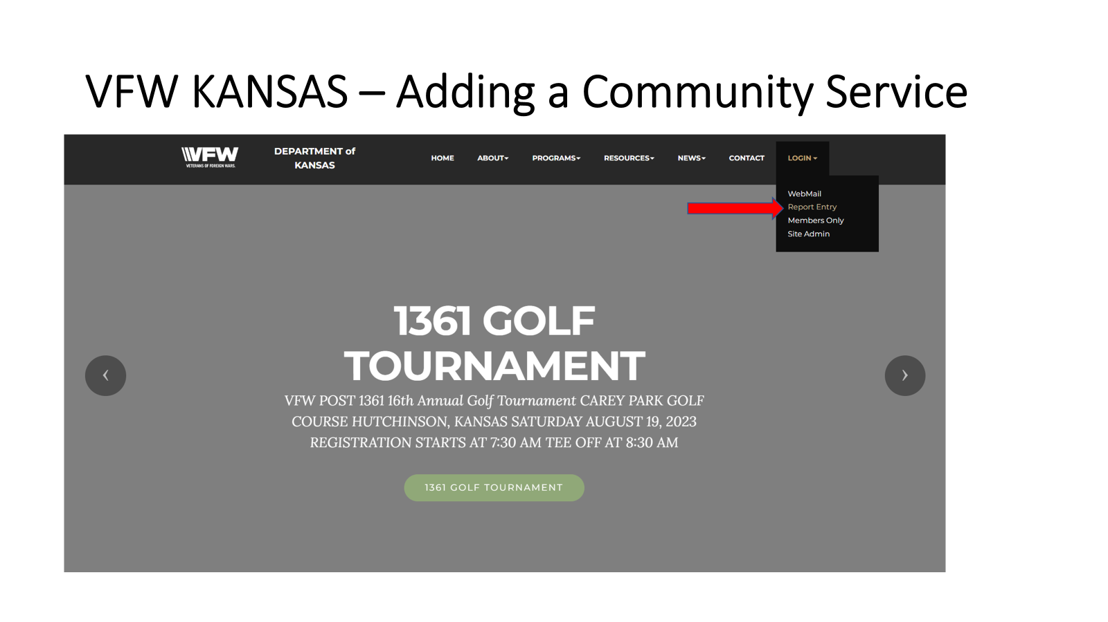

Slide 13
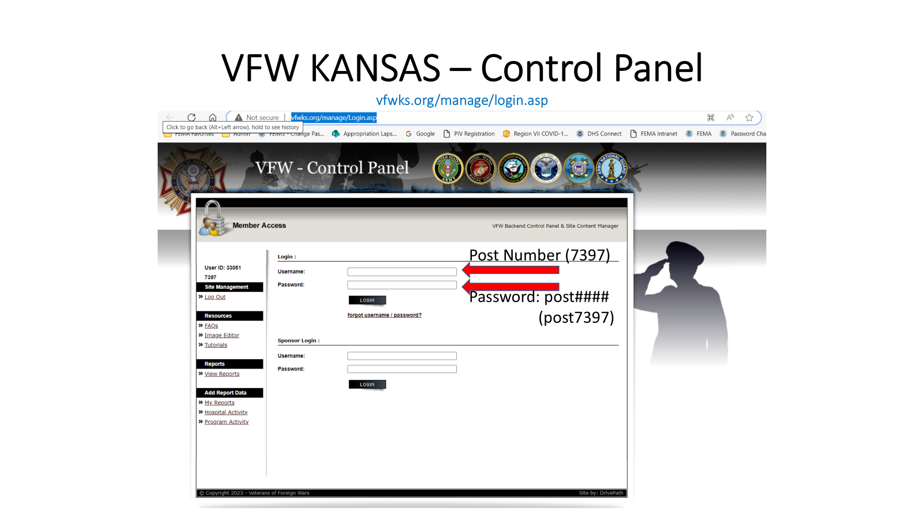

Slide 14
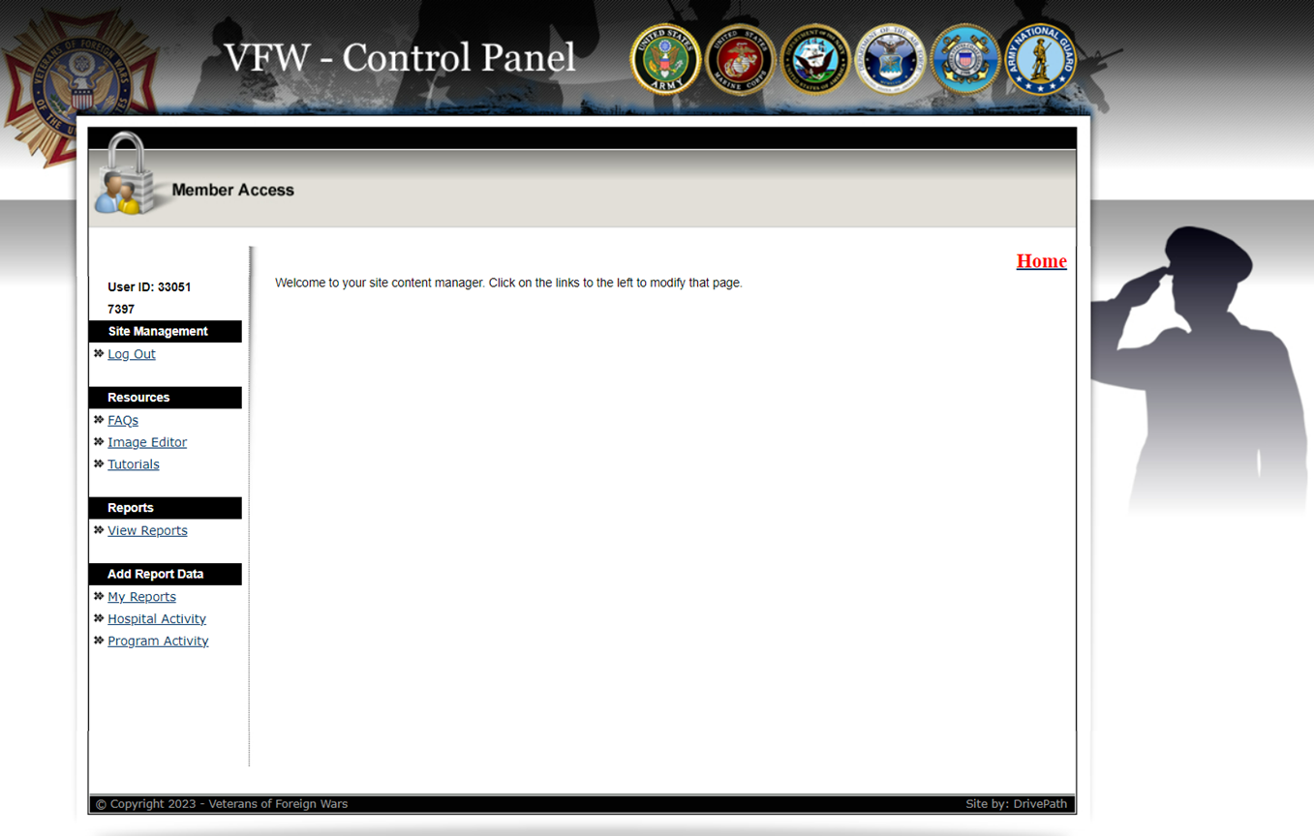

Slide 15
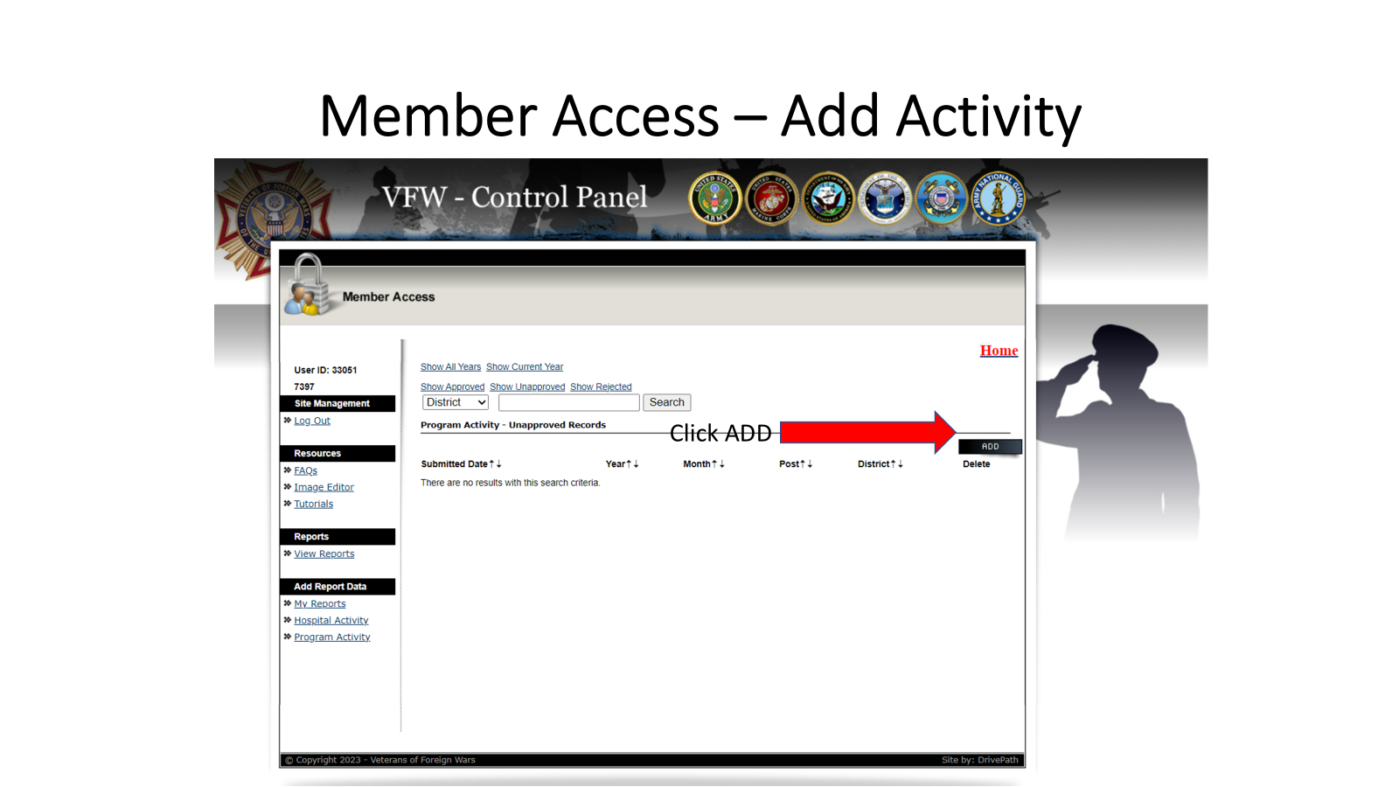

Slide 16
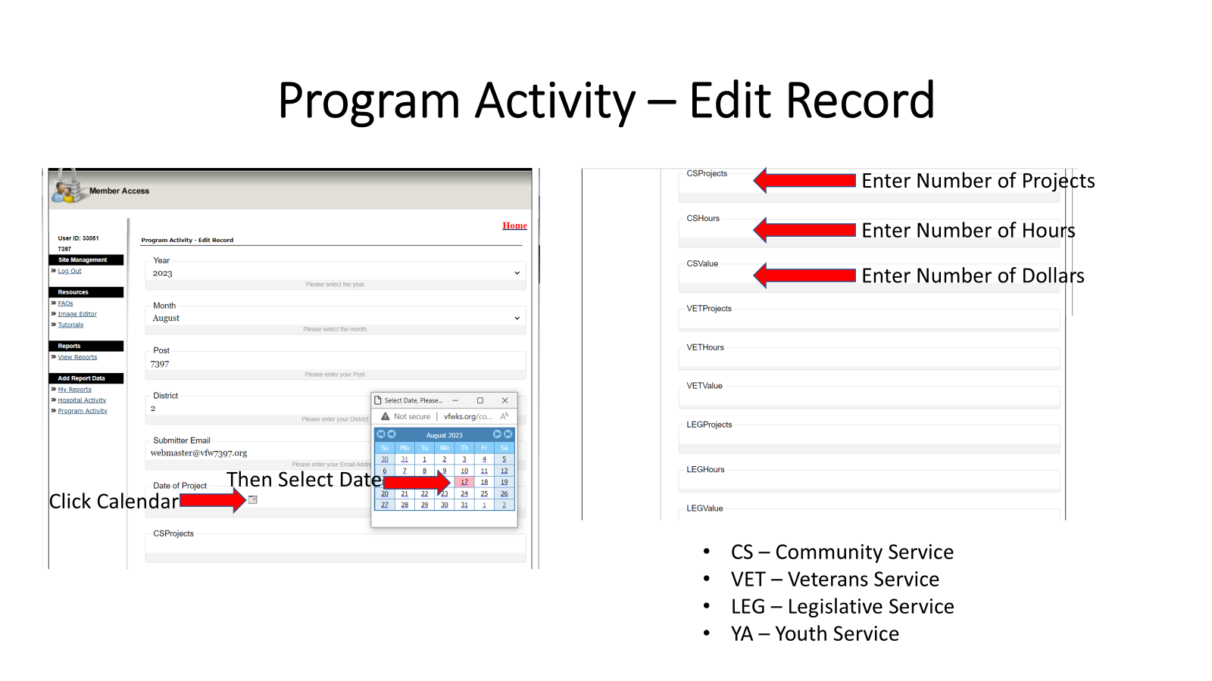

Slide 17
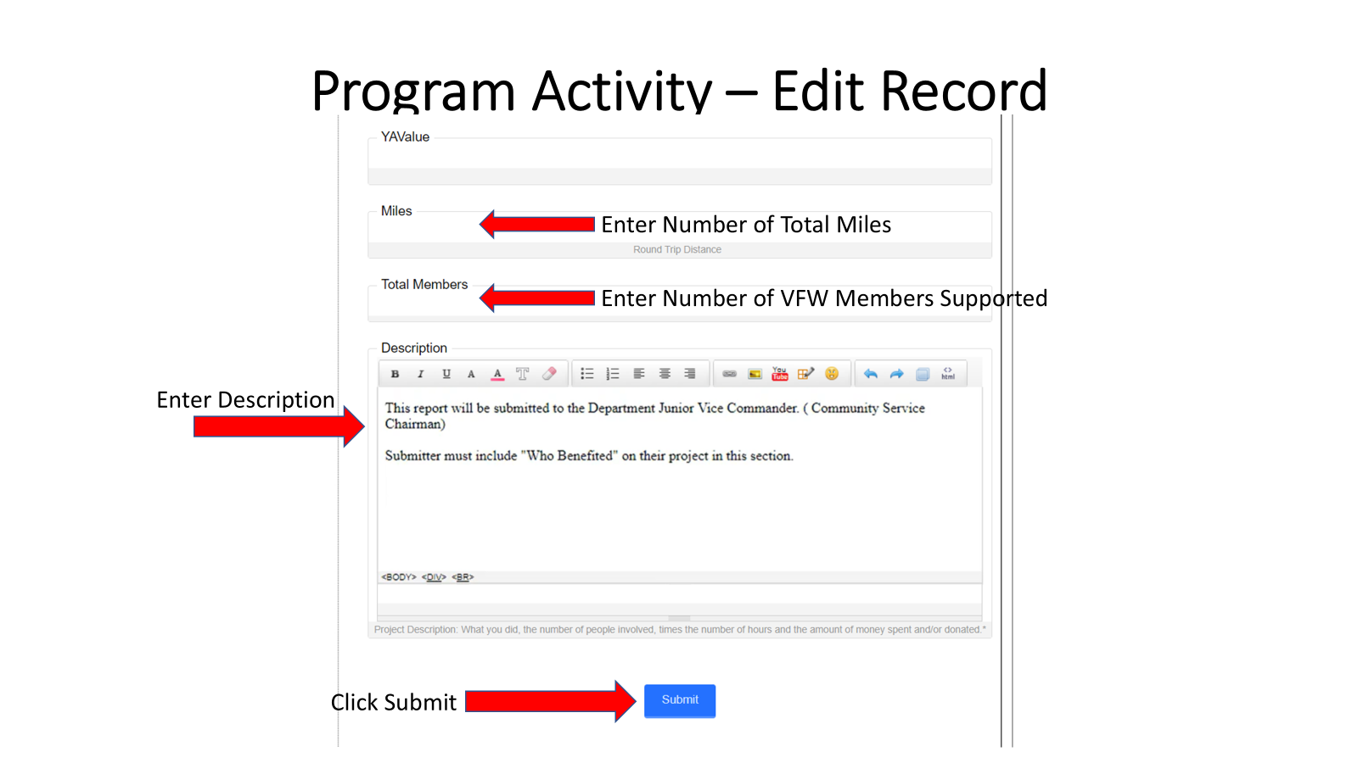

Slide 18
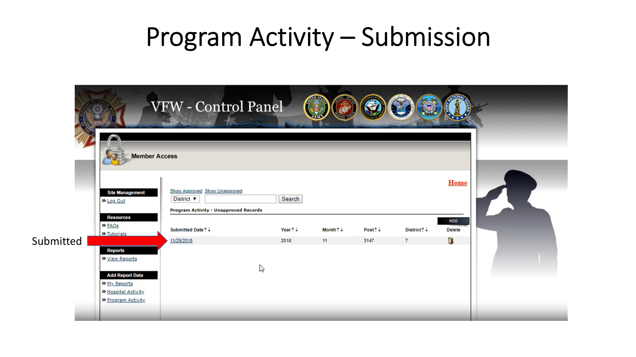

Slide 19
Questions
Rich Wahlmeier
Junior Vice Commander
Department of Kansas
jvc@vfwks.org
785.726.1294

