Slide 1
Membership
Program
2026–2027
Department of Kansas School of Instruction

Slide 2
All-State Requirements
Find the requirements at vfwks.org under the “Programs” tab
Post
100% or above in membership — mandatory
VMS/NVS donation of $125 and National Home Kansas House donation of $100 by April 1, 2027
Community Service: 6 approved projects in each of the four categories
Buddy Poppies: 3 per member, rounded to the next 100, max 500 ordered by April 1, 2027
Post Commander or representative at all District meetings
Quartermaster bonded; September, December, and March audits on time
Three of the ten programs completed by April 1, 2027
Entry form to Department Headquarters by April 10, 2027 — up to 10 Posts selected

Slide 3
All-State Requirements Continued
District
District must be at least 100% in membership
Advance one Voice of Democracy, Patriot's Pen, and Teacher entry to Department
All audits submitted by the end of the month following the District meeting
District Quartermaster adequately bonded through all four audit periods
Post inspection forms to Department Headquarters by December 1, 2026
State Fair: District must have its own planned day and participate
National Home fundraiser tickets and money turned in by May 31, 2027

Slide 4
All-State Check Sheet
Pass/fail items — miss one and the entry is out
100% or above in membership
VMS/NVS donation of $125 and National Home donation of $100
Buddy Poppies ordered: 3 per member, rounded to the next 100, max 500
Quartermaster bonded for the full year
September, December, and March audits submitted on time
Post Commander or representative at all District meetings
Entry form to Department Headquarters by April 10, 2027

Slide 5
All-State Check Sheet
Requirement | Deadline | ✓
Post at 100% or above in membership | June 30, 2027
VMS/NVS donation of $125 | April 1, 2027
National Home Kansas House donation of $100 | April 1, 2027
Buddy Poppies: 3 per member, rounded to next 100 | Ordered by April 1, 2027
Community Service: 6 projects in each of 4 categories | April 1, 2027
Three of the ten programs completed | April 1, 2027
Quartermaster bonded for the full year | All year
September audit submitted | October 31, 2026
December audit submitted | January 31, 2027
March audit submitted | April 10, 2027
Post Commander or rep at all District meetings | All year
Entry form to Department Headquarters | April 10, 2027
Every item is pass/fail — miss one and the entry is out.

Slide 6
All-State Grading Sheet and Slots
Graded on points from the entry form — more points, better odds
Category I: complete 3 of the 10 programs by April 1, 2027
Category II: 6 approved community service projects in each of the four categories
5 bonus points if the March 2027 audit is postmarked by April 10, 2027
Department allocates up to 10% of its Posts — about 10 of roughly 100 Kansas Posts
Department Commander may approve more if justified
Open slots may go to Posts short only on membership that hit 100% by June 30, 2027

Slide 7

All-American Program
Download the National Membership Program: log into your OMS account at vfw.org, scroll down to “Membership Quick Links,” and click Membership, Recruiting & Retention. It is located at the top of the page.

Slide 8
All-American Post Criteria
Meet the divisional membership quota, no adjustments for deceased Life members
At least 80% retention of prior year Annual members
Election report submitted and Post in good standing
Voice of Democracy, Patriot's Pen, and Teacher entries advanced by January 31, 2027
$125 to National Veterans Service and $75 to DPAA via the Programs Dashboard
Quarterly community service reports plus a 5% increase over last year
Participate in the VFW Day of Service in May
Buddy Poppies: 5 per member, minimum of 500

Slide 9
All-American Post Membership Quotas by Division
Division | Minimum Membership | Maximum Membership | Membership Quota
1 | 501 | --- | 103%
2 | 351 | 500 | 104%
3 | 246 | 350 | 105%
4 | 190 | 245 | 106%
5 | 150 | 189 | 107%
6 | 125 | 149 | 108%
7 | 105 | 124 | 109%
8 | 90 | 104 | 110%
9 | 70 | 89 | 111%
10 | 50 | 69 | 112%
11 | 10 | 49 | 113%
Source: VFW National Membership Program, page 5 — your quota depends on your Post's size.

Slide 10
All-American District Criteria
Exceed prior year membership based on June 30, 2026 totals (100% + 1)
Finish in the top 20 Districts in your division on membership percentage
$100 restricted donation to DPAA through the Programs Dashboard
District election report submitted and in good standing
Voice of Democracy, Patriot's Pen, and Teacher entries advanced to Department by January 31, 2027
Top 10 Districts per division earn the Commander's cap, badge, and pin
Top 2 District Commanders per division receive a $1,000 award

Slide 11
Who Gets the Cap, Badge, and Pin
Posts: top 15 in each of the 11 divisions — about 165 Post Commanders earn the cap, badge, citation, and pin
Top 5 Post Commanders per division: up to $1,000 toward National Convention
Top 2 Post Commanders per division: Captain and Co-Captain, with a special cap designation
Districts: top 10 in each of the 6 divisions — about 60 District Commanders earn the cap, badge, and pin
Top 2 District Commanders per division: $1,000 stipend. Divisions are set by membership size, so you compete against Posts your own size

Slide 12
Retention: The 80% Standard
National requires at least 80% retention of prior year Annual members
Retention = Annual members renewed ÷ prior year Annual members in good standing
Fall below 80% and the Post is out of the All-American running
Retention also drives the $1,000 Recruiting and Retention Challenge grants
Every lapsed member you bring back raises the number
Work the Unpaid List all year long, not just in June

Slide 13
Review the Expiring List Every Week
Post Commanders and Quartermasters should be reviewing the Post Query’s expiring list weekly
Plan to call members whose membership expires at the end of the month around the 15th, add this to your personal calendar as a recurring task
Use the call as a Buddy Check and remind them to renew their membership

Slide 14
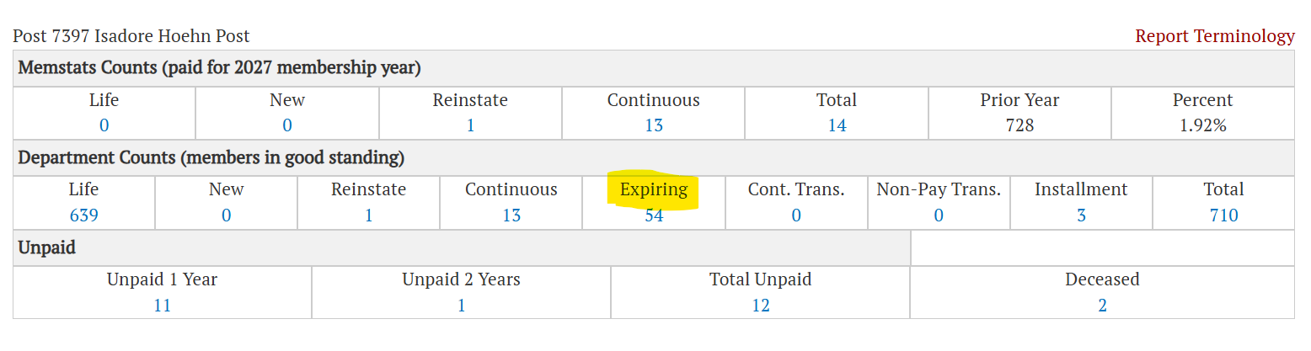
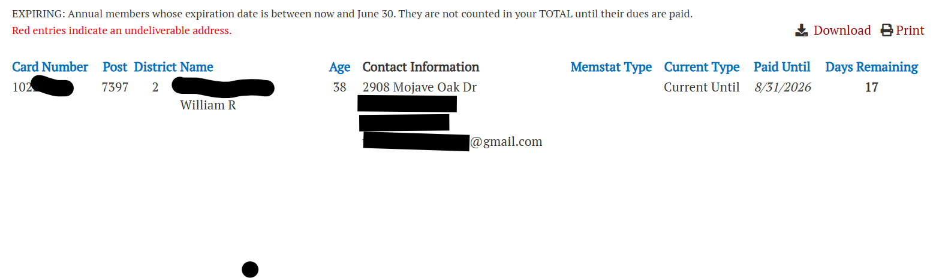
Post Query: run the expiring and unpaid reports

Slide 15

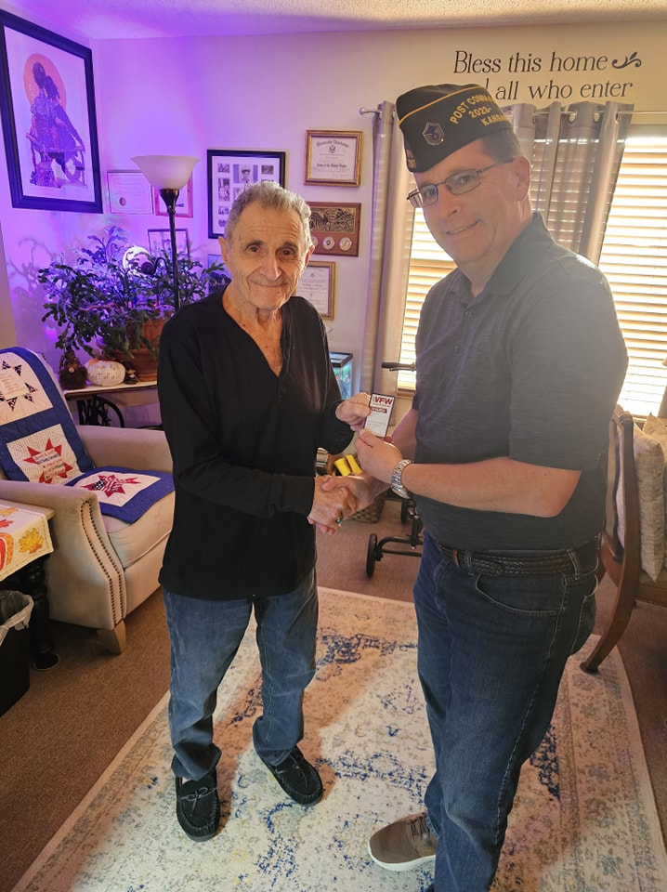
Bring Back and Renew Those Lapsed Members
How many here have gone door to door to visit Unpaid members and to collect dues?
Get a group of members together on a Saturday and make those Buddy Check calls and knock on those doors.

Slide 16
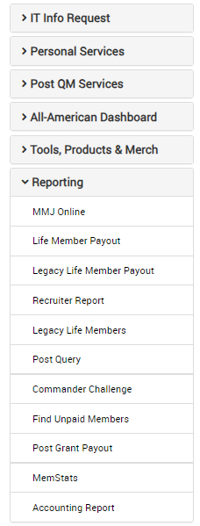
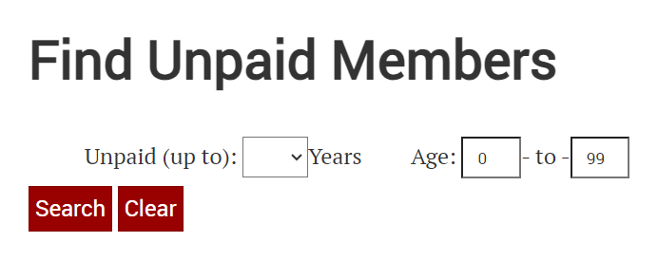


Unpaid List
Find Members
Note: Unless you are looking for a specific member or certain number of years unpaid, leave the fields blank and click on “Search.” This will retrieve all “Lapsed” members of your Post from 2002 to present.

Slide 17
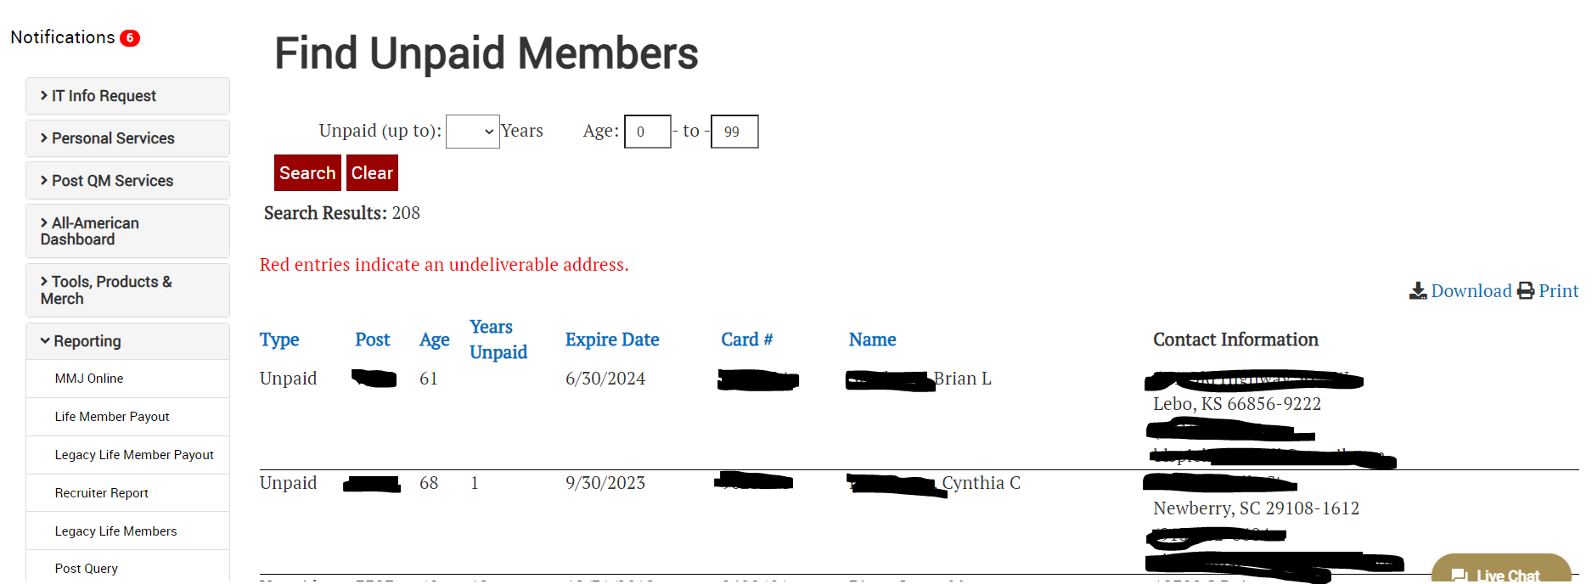
List of All Post Unpaid from 2002–Present
Every lapsed member still on your roster — work this list all year

Slide 18

Let’s Have a Great Year!
Celebrate our 2026–2027 successes at the Department Convention in Topeka in June
Then let’s all head to Milwaukee at the end of July and have a big party — let them know Kansas VFW is in town!

Slide 19
Questions

